Slide 1
4th grade Curriculum Night
Ms. Crenshaw, Mr. Stone, & Mrs. Walden
School Year 2018-2019

Slide 2
WE believe…
  All students can learn!
  EQUITABLE means providing what is best for the individual child.
  Instruction is best delivered through a variety of models based on student needs and ability.
  We increase the likelihood of student success by creating a healthy, insightful circle of influence in which the child can learn…that means home and school.
  Caring and compassionate relationship development is as critical to student success as content; we love to laugh through learning!

Slide 3
Websites
www.madisoncity.k12.al.us
  Madison City Schools’ website
www.westmadison.madisoncity.k12.al.us
  West Madison’s website
  PTA – MemberHub
  Class DoJo - homeroom
  Sign up for NotifyMe
    News, closings, etc.

Slide 4
Class DoJo
This is our new school-wide discipline plan.
We are taking the month of August as a learning trial for the students . . . And possibly the teachers ☺
If you have not connected with your HOMEROOM teacher, please do so asap.
The three of us are connected with each other’s classes.
In September we will start using this as a way to determine who has earned Fun Friday. Each student will have to have earned a specified number of points and to NOT have lost a certain number of points as well.
We will let you and our students know the required point values the first week of September.

Slide 5
So how does my child earn points and lose them?
Positive Points
Great Drill Behavior +2
Hallway Behavior +1
Helping Others +1
On Task +1
Participating +1
Persistence +1
Ready to Work +1
Returned papers +1
Showed Kindness +1
Teamwork +1
Working Hard +1
Needs Work – Loss of Points
Disrespectful -1
Left trash out -1
Moved to Silent Lunch -1
No Name on Paper -1
Not Prepared for Class -1
Off Task -1
Out of Seat at Lunch -1
PE Timeout -1
Playground Issue -1
Talking -1

Slide 6
Class Schedule
MONDAY, TUESDAY, WEDNESDAY, & FRIDAY
7:45-9:55 - Core 1
PE @ 8:15-8:55
9:55-11:25 - Core 2
Spanish - 10:15-10:45 (Crenshaw on Wed, Stone
on Mon, Walden on Tues)
Art on Friday- Stone @ 10:00-10:35;
Crenshaw @ 10:40-11:15
11:25-1:45 - Core 3
Lunch @ 12:20 Walden, 12:25 Crenshaw,
12:30 Stone
Recess @ 12:50 Walden, 12:55 Crenshaw,
1:00 Stone
Counseling @ 1:45-2:25
(Crenshaw on Mon, Stone on Wed)
2:35 dismiss
THURSDAY
7:45-9:55 - Core 1
PE @ 8:15-8:55
9:55-12:10 - Core 2
Art @ 11:30-12:05 Walden
12:10-1:45 - Core 3
Lunch @ 12:20 Walden, 12:25 Crenshaw,
12:30 Stone
Recess @ 12:50 Walden, 12:55 Crenshaw,
1:00 Stone
Counseling @ 1:45-2:25 Walden
2:35 dismiss

Slide 7
Homework Expectations
Math – daily
Reading – Read 20 minutes every night; Must take two AR tests a week.
PAWPAD –
  Student writes down assignments.
  Yes, they do have time to write it down at the beginning/end of class.
Forgot it? –
  No going back to class for books, materials, or a book bag.
  No late work accepted without an excused absence.
  Grade will be a zero.
Make up work –
  Student is responsible for getting work from the teacher UPON RETURNING TO SCHOOL.
  Teachers will get work together for extended absences only.
  A zero will be the grade if work is not turned in.
Students may not call for homework, and parents should not bring it up to the school. Lessons learned at an early age are invaluable!

Slide 8
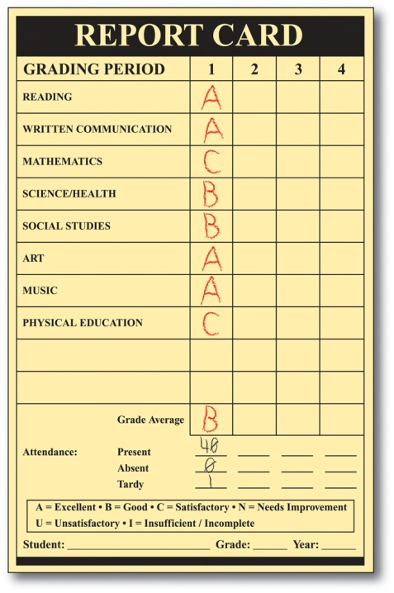
GRADES
INOW
  Please check your child’s progress frequently; grades are posted in real time.
  PROBLEMS? - Please make sure you contact the office (Mrs. Miller); teachers do not have passwords, pins, etc.
Science/Social Studies
  60% Assessments (Chapter Tests, Hands-on Experiments)
  40% Classwork
Reading
  60% Reading Assessments (weekly)
  20% Unit Assessments
  20% Language Assessments (Grammar, Writing, Homework)
Math
  50% Assessments (Chapter tests, weekly tests, quizzes)
  20% Application (performance tasks/project-based)
  20% 9 weeks test
  10% Timed Tests

Slide 9
AR Points
How AR goal is determined
  Individual AR reading level (STAR test) using a 9 week schedule based on 20 minutes of reading a day
  This goal determination chart is on the Renaissance Place website or WMES website
AR is not graded. However, students are required to take an AR test weekly.

Slide 10

Room Parent
It’s not just for Mom anymore!!
Expectations from us . . .
  We would love it if parents would pick up our lunch for us on Fridays!
  Class party in December and May
    Make sure there is enough finger food (variety), plates, paper towels, etc.
Coordinate with other parents for assistance

Slide 11
Early Dismissal
Make sure you have a copy of how you told us your child will go home, because that is how we will send them.
Listen to the news . . . Better yet . . . Make sure you are signed up for NOTIFYME. Download the MCS App!
If you send us an email changing your plans for that particular day, we cannot guarantee that we will see it. These days are usually quite hectic . . . especially in severe weather.
If we are in the basement, and you come to check out your child, make sure you sign out with us!!

Slide 12
Questions??
Please contact us by email if you have any concerns or questions throughout the school year. This is the fastest method of communication for everybody. You can also contact us through ClassDoJo!
lwalden@madisoncity.k12.al.us
mwstone@madisoncity.k12.al.us
vcrenshaw@madisoncity.k12.al.us

Slide 13
We look forward to a wonderful
year full of our students working
together and meeting their new
challenges in fourth grade!
Thank you so much for sharing your child with us in 2018-2019!!

